Slide 1



Understanding Major League Baseball Attendance
March 25th, 2023
Who’s on First
Aakriti Aneja, Ram G S, Justin Mason, Divyansh Tripathi
University of Minnesota – Carlson School of Management
Notes:
Hello everyone. We are team who’s on first, group of graduate students from Carlson School of Management. I am Aakriti and I am here with my team – Justin, Divyansh and Ram – and we’re here to present our analysis on trends in Major League Baseball attendance - which can be used to take informed business decisions

Slide 2







Baseball - America’s Favorite Pastime is facing more competition than ever
As a business we want to deliver the best possible experience to the fans
Knowing what affects attendance and expected attendance helps us take informed business decisions leading to best possible fan experience
Notes:
Baseball has a huge star studded and nostalgic history, and it has always been America’s favorite pastime.
But lately baseball has been facing more competition than ever. Competition from streaming services like Netflix, Youtube, Hulu; Video Games; other professional sports like NBA, which has always competed with baseball and even the movies.
Baseball has to fight for fan’s attention because of so these entertainment sources
As a Major League Baseball and as a business, we’d want baseball to gain back its fans, and for that we want to deliver best possible experience to the fans.
Knowing what affects attendance and what makes fans show up to the stadiums are a big factor in taking informed business decisions, that can help deliver that best possible fan experience, and, thereby driving profitability for Twins and MLB in general

Slide 3
Our Solution is a one-stop-shop to take informed business decisions
Our Solution
Interpretability
What affects Attendance?
&
To help manage finances, drive profitability & fan experience
Predictive
Expected Attendance
Notes:
And how do we do that, enter our solution!
Our solution is a one stop shop to help MLB organizers take informed business decisions.
It comprises of two components, an interpretability component that defines what affects and drives attendance, and a predictive component which estimates the expected attendance for games in upcoming season and within season
Both of these in tandem can be used to manage finances like operations and marketing budgets and drive profitability & deliver the best possible fan experience

Slide 4
Data Sources
Primary Source
Game-Logs were used as the primary data source from which we team attributes (such as win record, rank, attendance), player attributes, and calendar features.
External Sources:
Weather data: meteostat API - The data provided by organizations like NOAA and DWD
Holidays: Holidays API – Federal Holidays list in the US
Demographic & Economic indicators:
Population - US Bureau of Labor Statistics
Consumer Price Index (CPI) - US Bureau of Labor Statistics
Unemployment rate - US Bureau of Labor Statistics
MLB team information:
Division – ESPN
Payroll / Salary – The Baseball Cube
Notes:
Our solution is data driven, and to create this we have used a whole lot of data.
Our Primary source of data are the game logs, which we used to engineer some new features like win records, team ranks and other.
We have also used data from external sources, like weather data provided by NOAA and DWD
Holiday information from Federal Holiday list of the states
Demographic and Economic indicators like Population, Consumer price index from US bureau of Labor Stats
And we scraped the web for MLB team information from sources like ESPN and the baseball cube
All of this data comes together in our solution to give us beautiful insights. Let’s take a deeper dive into what our model can do!

Slide 5

Top Factors influencing Attendance for Minnesota Twins
Our Solution
Interpretability
Predictive
Day of Week
(Mon vs Sat)
Holiday Games
Month of the year (Apr vs Aug)
Last Season Rank
MIN Last Season League Rank
Unemployment rate
NBA Games

Slide 6
Top Factors influencing Attendance for Minnesota Twins
Our Solution
Interpretability
Predictive
+14%
+12%
+12%
Month of the year (Apr vs Aug)
Day of Week
(Mon vs Sat)
+2.5%
+2.2%
+2.2%
Holiday Games
Last Season Rank
Last Season Rank
Unemployment rate
NBA Games
-1.5%
-11%

Slide 7






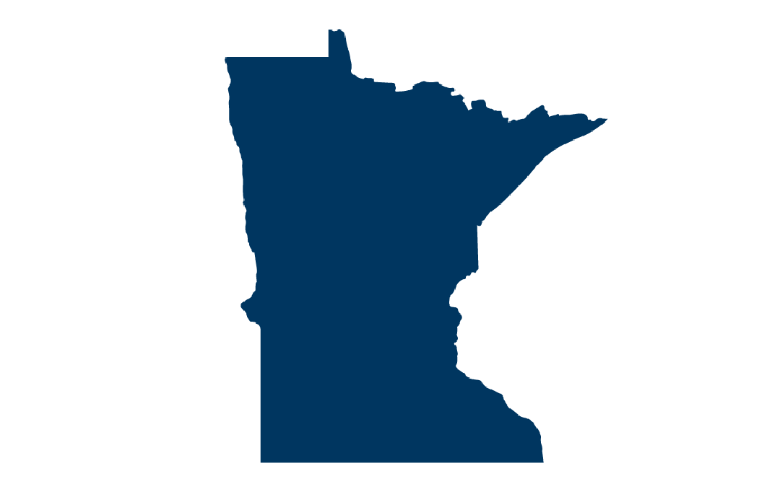
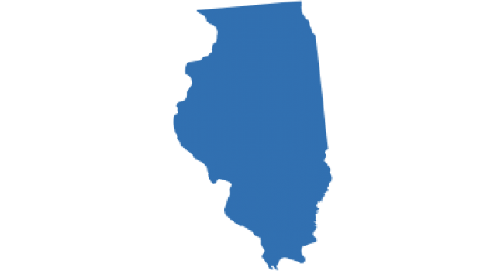
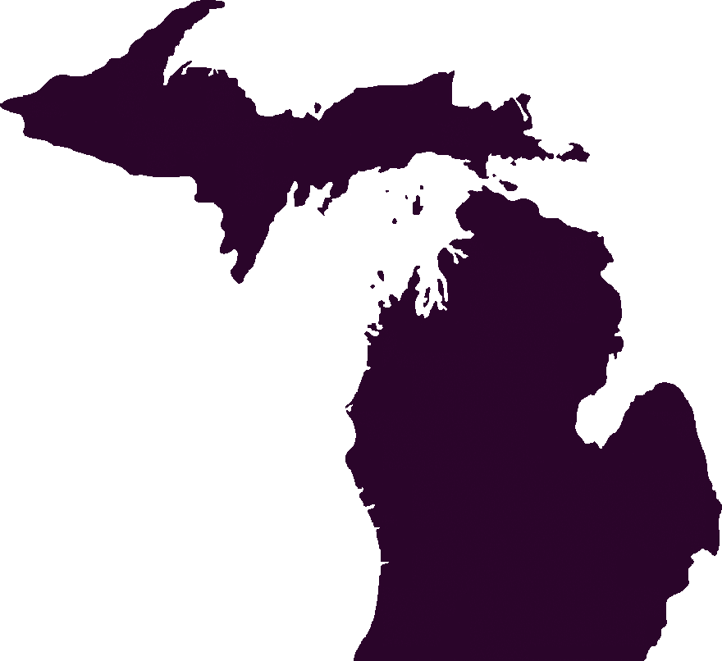
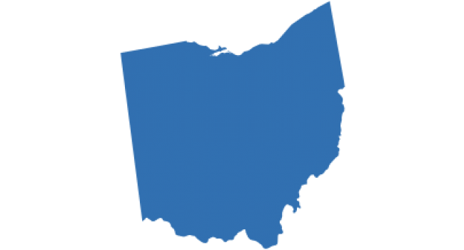
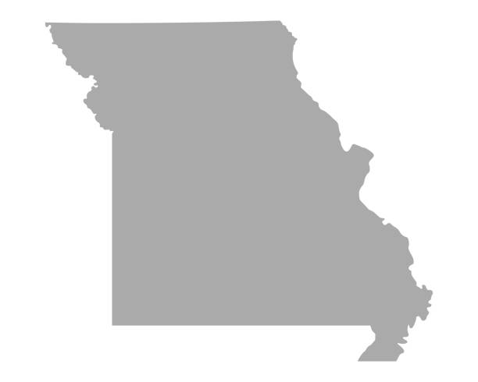
Factors influencing attendance across Divisions
*For recent seasons
Our Solution
Interpretability
Predictive
Geography
Weekday
Covid (Residual)
NBA Season
AL Central
Highest attendance in
June & Aug
Colder states see highest attendance in warmer months
AL West
Attendance NOT
affected by the
day of the week
Only division indifferent to week games (M-Th)
NL Central AL East
Still have not recovered their attendance to pre-Covid levels
Some division are affected by Covid more than others
AL Central
Drop in attendance during NBA season
Only division affected by other prof sports
-6.5%
12%
4%
Notes:
Has MIN recovered from Covid effect?

Slide 8
Factors affecting Baseball Attendance over the years
Our Solution
Interpretability
Predictive
2007
2022
+3%
Day Games
+1%
Weekend Games
Weekday Games
-3%
Visiting Teams NYA, SEA
+16%
-10%
Visiting Teams PIT, BOS
Notes:
1. Day games have become more popular over the years
2. Weekend games attract more fans in 2022 than 2007
3. Weekday games attract less fans in 2022 than 2007
4. On average, when NYA & SEA are visiting teams, they attract more fans in 2022 than 2007 ; when SLN, PIT & BOS are visiting teams, they attract less fans in 2022 than 2007

Slide 9
Predictive Component – Season’s attendance
Our Solution
Interpretability
Predictive
Predicting 2022 Season’s Attendance
+19.1%
+10.3%
+13.2%
+4%
Ensemble
Seq 2 Seq
XGBoost
LightGBM
Baseline: Home team’s average attendance over the last 20 season (excluding covid effect)
RNN
-145%
*Evaluation Metric: Mean Absolute Error (MAE)

Slide 10
Predictive Component – In-season attendance
Our Solution
Dynamically Predicting Attendance for next 7 days (In-Season)
Interpretability
Predictive
+48%
+9.2%
LightGBM
Ensemble
Baseline: Average attendance for home team – visiting team combination of latest seasons
RNN
Seq 2 Seq
XGBoost
-13%
-70%
-245%
*Evaluation Metric: Mean Absolute Error (MAE)

Slide 11
Our solution can help organizers take informed decisions
Operational
Operational Decisions
Staffing, Stadium Preparations, Concession stands etc.
Our Solution
Interpretability
Sales and Revenue
Operational Decisions
Pricing, Promotions & Special Event Placement, Discounts & Offers
Predictive
Financial and Strategic
Operational Decisions
Budgeting, Revenue Estimation, Marketing Strategy
Notes:
Now that we looked at a few highlights of our insights, let’s take a look at how our solution fits in, to adding business value. What we aim at doing is to help organizers of MLB take informed business decisions.
As we saw, we have an interpretability model, which is a Seasonal ARIMA-X with Linear regression and an Ensemble dynamic predictive model. In tandem, these can be used to make various business decisions such as, operational decisions like staffing; Sales and Revenue decisions like Promotions and Financial & Strategic decisions like Budgeting.
I would like to take a couple of examples to show how this could be done.

Slide 12
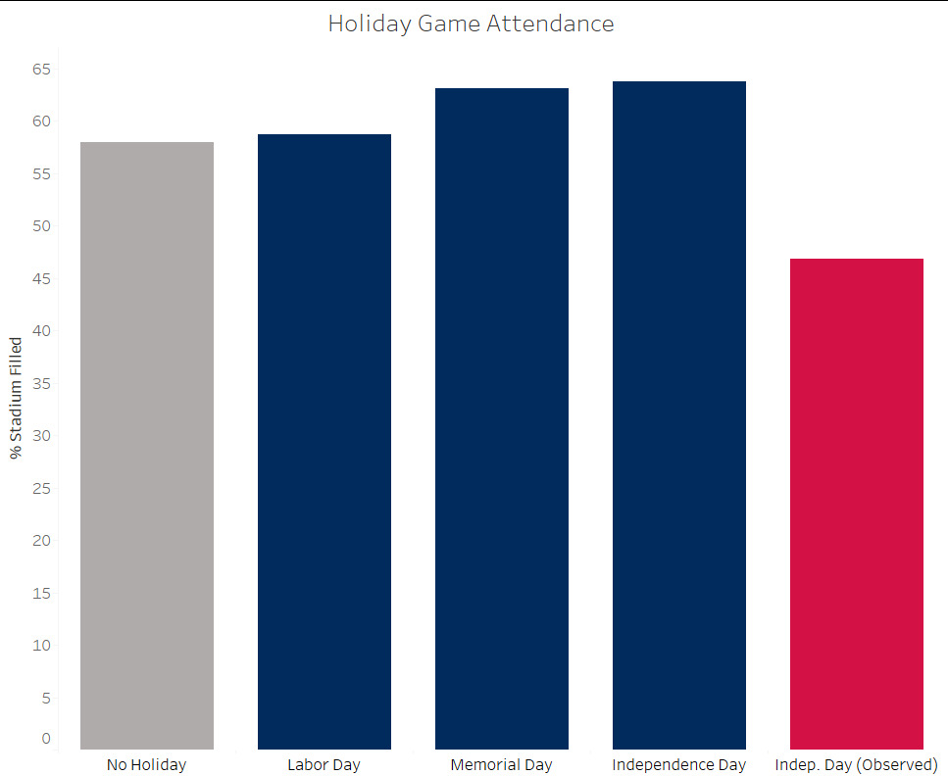
Holiday Games Drive High Attendance
1% | 4% | 6%
Labor Day | Memorial Day | Independence Day
However, Observed Holidays have negative effect (11.5%) on attendance – given the long weekend
Expected Attendance (Predicted)
Operational Decisions
Operational
Optimizing # of concession stands, staff required
Sales and Revenue
Operational Decisions
Potential Special Event placement
Financial and Strategic
Marketing Budget optimization
Notes:
Alright, this is an interesting one, the chart on the left shows % attendance on specific US Federal Holidays. Attendance is on average high for holidays in general ,as we saw earlier. But I want to focus on the last bar with low attendance, which is Independence day observed. It usually occurs during a Friday or a Monday – indicating long weekends. It could be that fans prefer to go out of station or visit family far away during these long weekends.
Equipped with this knowledge and the predictions from the model, what can we do?
One, for example, optimizing number of concession stands and staffing requirements on these holidays.
Or, a potential special event placement – to attract more people and encourage them to stay back for the game.
On the other hand – from a marketing budget optimization lens – we may not want to spend too much on marketing games that are expected to get high attendance due the attendance driving holidays.

Slide 13
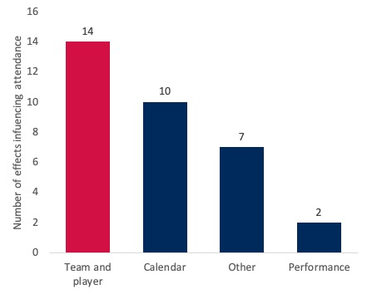



Teams and players are the largest significant factors driving attendance
Top visiting teams
25%
18%
17%
Expected Attendance (Predicted)
Operational Decisions
Operational
Optimizing # of concession stands, staff required
Sales and Revenue
Operational Decisions
Special events to offset worse teams
Financial and Strategic
Market teams and players
Notes:
To show another example, from our interpretability model, we found that teams and players are the largest significant factors driving attendance, meaning good teams and good players cumulatively bring in more attendance than any other factor.
Here, we’ve listed down top visiting teams for the Twins.
Again, with this quantifiable knowledge of good vs bad teams and the predicted attendance for these games, what can we do?
Have special events to offset low attendance when worse teams come down to play
Or market specific teams and specific players in teams, for example, even if a team doesn’t do well, if players in the team are popular, we can leverage this effect to publicize the game.
With that, let’s now take a look at our Schedule Optimizer for the Twins

Slide 14


Schedule Optimization – What can we control?
We can control and experiment with three dimensions
1
2
3
On which dates should the twins play?
Should the Twins play during Day or Night?
When should the Twins play their different opponents?

Slide 15


Method for Schedule Optimization
Combinations Generated
10,000
10,000
35
Number of Simulations
Bayesian Search
10,000
Projected Attendance Lift
32%
Optimal Schedule
Notes:
We create 10000 different combinations of dates (keeping the 41 day constraint). 10000 different combinations of day/night games. And match those gamedays with the 35 different combinations of series of opponents. We run a 1000 trials with an objective to maximize attendance using Bayesian Search to find the optimal set of parameters in this space.

Slide 16
Why is the schedule optimal?
1
Prioritizes June to August, with 43% of games scheduled during those months.
2
54% of weekend games are day-games, while only 24% weekday are day games.
3
Only 40% of big-ticket games are on weekends compared to 54% of the other teams
Notes:
1. June to August are the best months for the AL Central league and are positively correlated to attendance in MN games as well.
2. Identifies optimal combination of Weekday and Day/night scheduling.
3. Distributes big-ticket opposition so that attendance is maximized throughout the season

Slide 17


Why chose our solution?
1
2
Incorporate Interpretability and Predictive models to help give Direction & Quantify business decisions
Holidays drive high attendance for MN Twins
Teams and players are the largest attendance driving factors
Predictive Models & Optimizer
Use state-of-the-art methods
Provide ~19% better season predictions and 48% better in-season predictions
Create schedule which could boost attendance by 32%

Slide 18
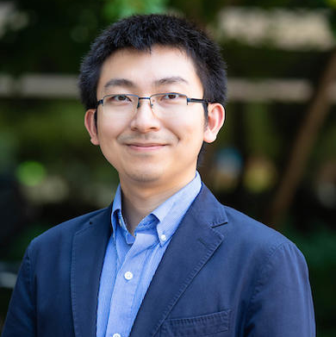
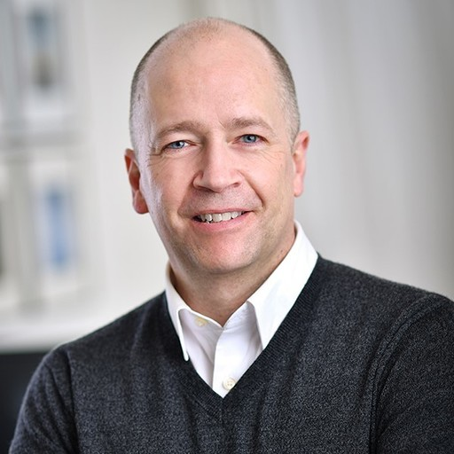
Special Thanks!
Mochen Yang
Faculty Advisor
Lee Thomas
Communications Expert
Notes:
We want to extend a special Thanks to our Faculty Advisor Prof. Mochen Yang and our communication advisor Lee Thomas, for their consultation on this specific project and though out our MSBA journey.

Slide 19
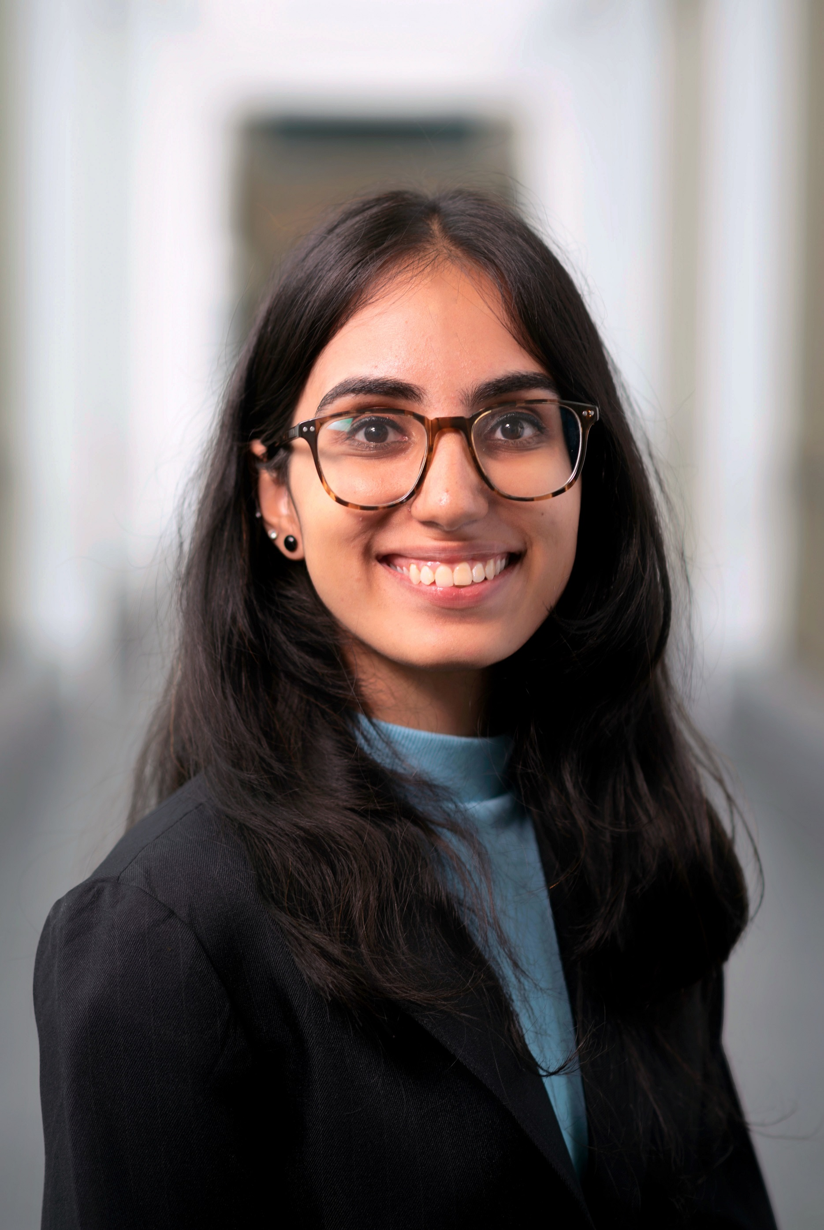
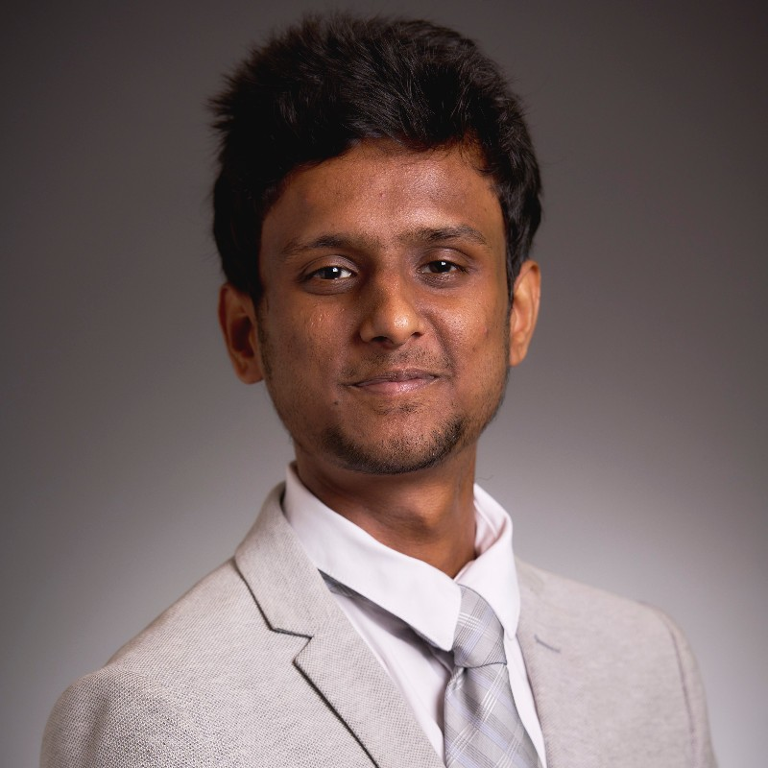
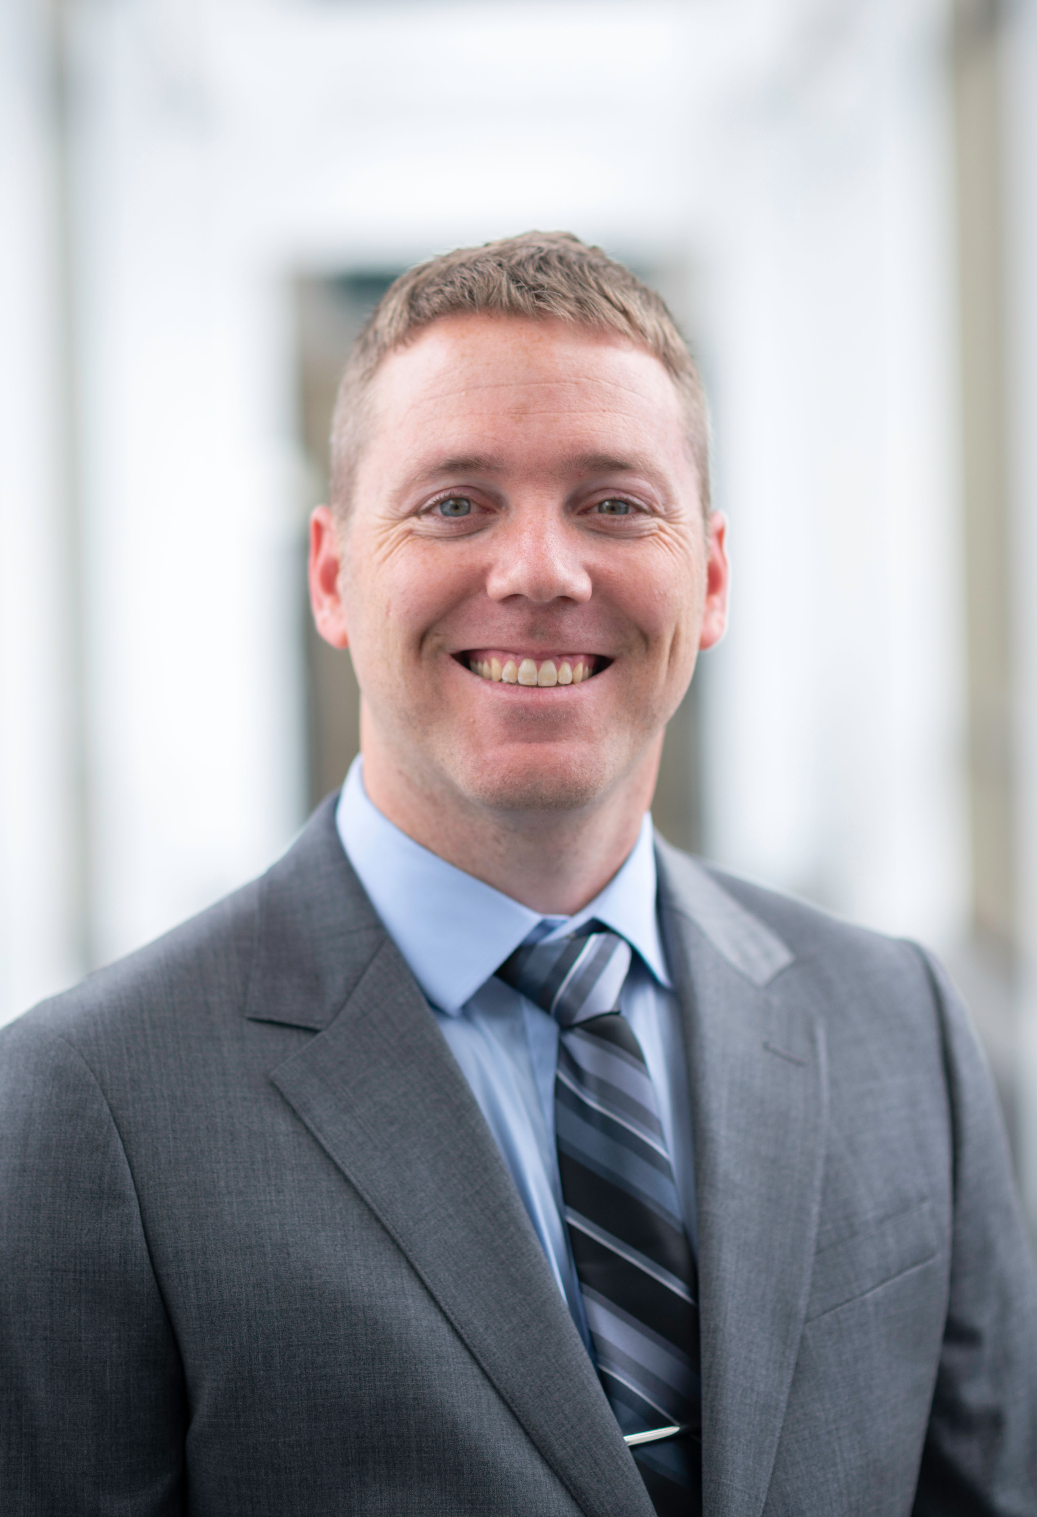
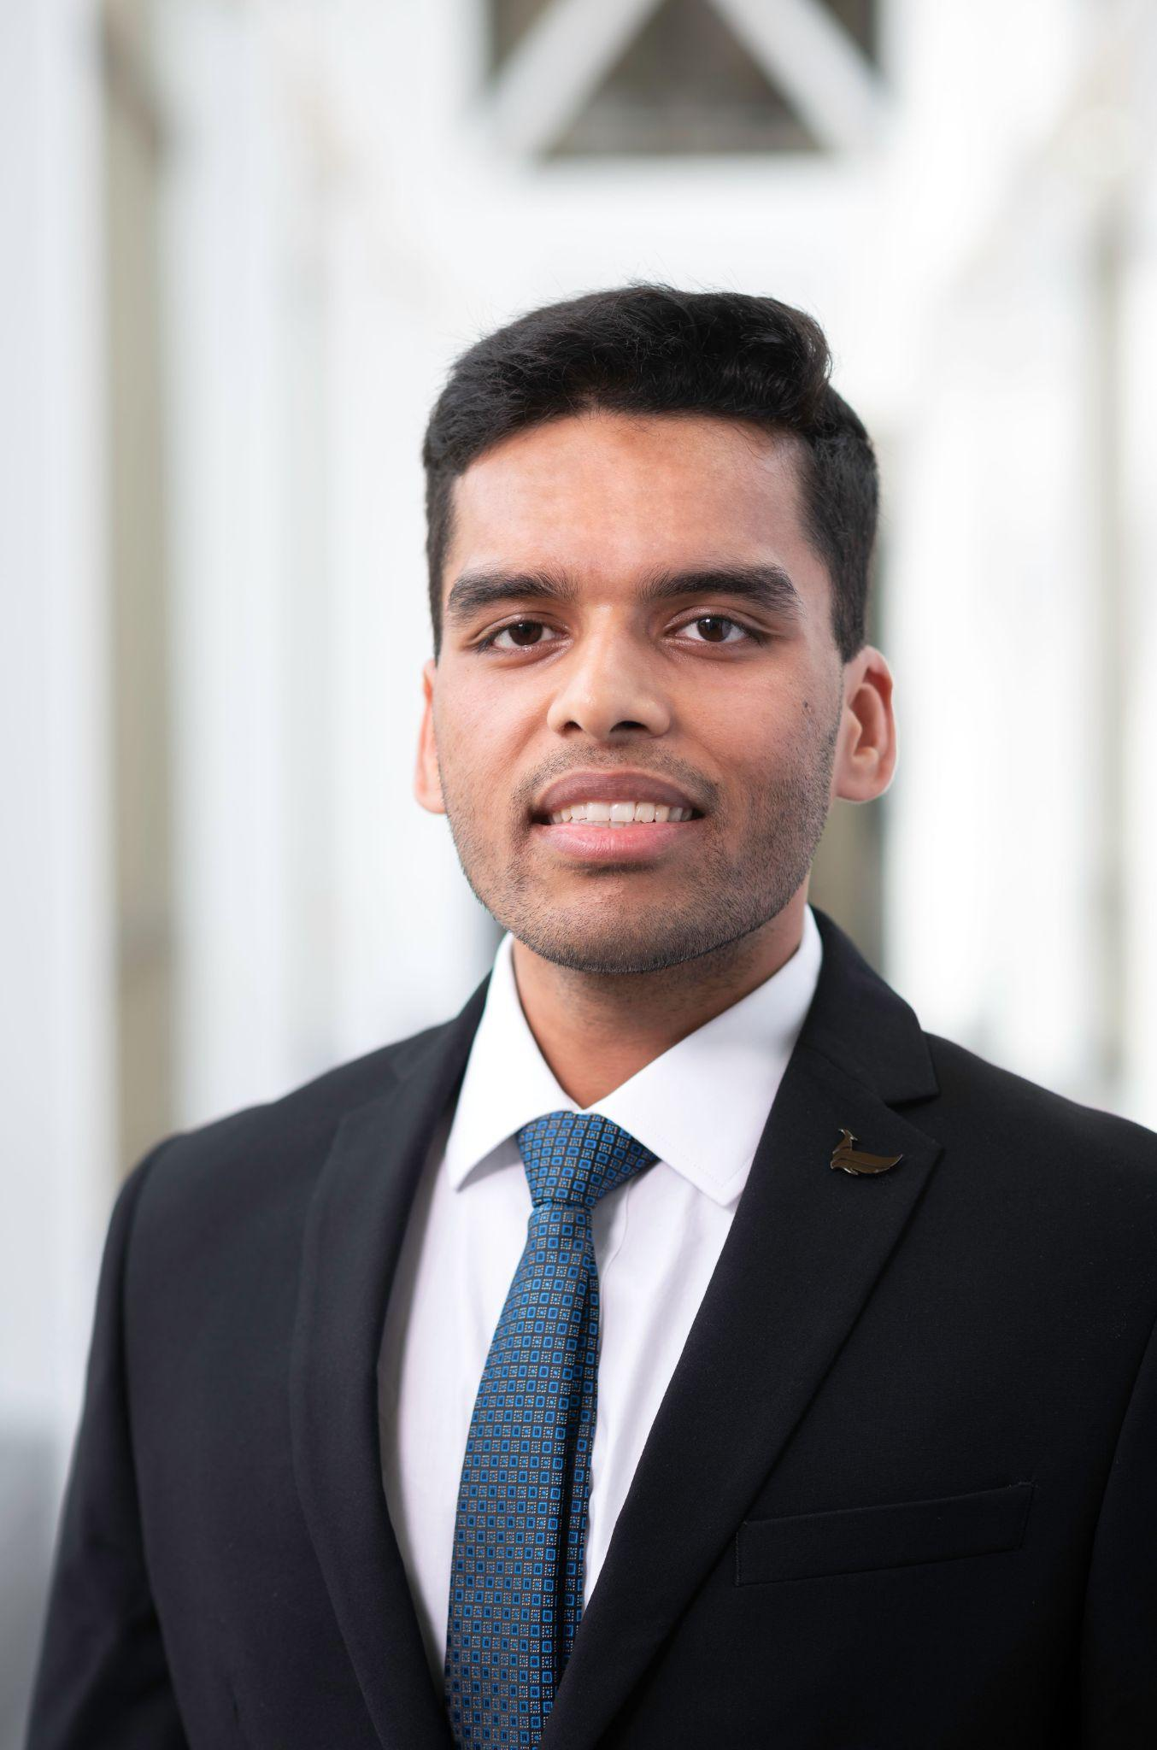
Meet Our Team – Who’s on First
Aakriti Aneja
MSBA Class of 2023
aakritianeja.umn@gmail.com
Ram G S
MSBA Class of 2023
egsram@gmail.com
Justin Mason
MSBA Class of 2023
justinkmason@gmail.com
Divyansh Tripathi
MSBA Class of 2023
divyanshmani@gmail.com
Notes:
Thanks for your time to go through our presentation and solution. We’re a team of Business Analytics students, graduating this summer in May. Please feel free to reach out to us if you’d like to talk more about our solution or talk about analytics in general, we would be happy to chat. Our contact information is on the slide, and we would love to hear about your analytics journey and any opportunities you may have for us.
Thanks again, and have a great day!

